Slide 1
Basic Docker commands
Course Code: INT332

Slide 2

$ docker --version
Docker version 18.09.6, build 481bc77

Slide 3
2. Docker info
Get detailed information about docker installed on the system including the kernel version, number of containers and images, etc.
$ docker info
Containers: 3
Running: 1
Paused: 0
Stopped: 2
Images: 3
Server Version: 18.09.6
Storage Driver: overlay2
Backing Filesystem: extfs
Supports d_type: true Native Overlay Diff: true Logging Driver:

Slide 4
3. Checking History
.
Shows the history of a docker image with the image name mentioned in the command
$ docker history httpd
IMAGE CREATED CREATED BY SIZE COMMENT

Slide 5
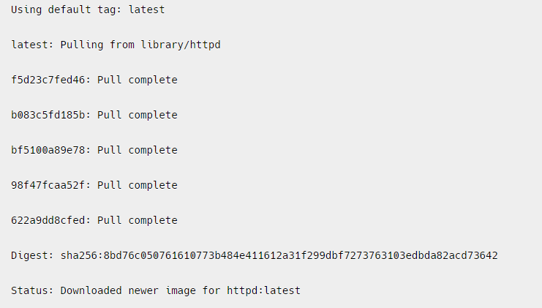
4 . Downloading Image
When we need to pull the docker image from dockerhub (docker repository) then ,the following example of pulling the the image and here we are taking Apache HTTP server image.
$ docker pull httpd

Slide 6
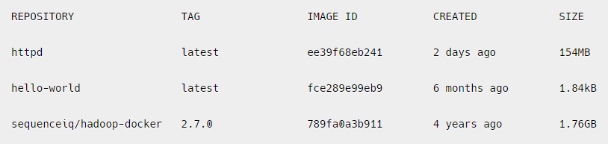
5. Images
To list all the docker images pulled on the system with image details such as TAG/IMAGE ID/SIZE etc.
$ docker images

Slide 7
6.RUN
The ‘docker run’ command is used to create and start a new container from a Docker image. The basic syntax of the ‘docker run’ command is as follows:
docker run [OPTIONS] IMAGE [COMMAND] [ARG…]
where,
OPTIONS: optional flags that configure the behaviour of the container, such as setting environment variables, mounting volumes, etc.
IMAGE: the name of the Docker image to be run.
COMMAND: the command to be executed when the container is started. If not provided, the default command specified in the Docker image will be used.
ARG: optional arguments passed to the command.
-d means

Slide 8
Options Available for executing Docker Run Command
Some commonly used options for executing the docker run command inside a container:
-it: Runs the container in interactive mode, allowing you to interact with the container through the command line.
-d: Runs the container in the background.
-- name: Specifies a name for the container.
-- rm: Automatically removes the container when it exits.
-p: Maps a host port to a container port.
-e / --env: Sets an environment variable inside the container.
-v: Mounts a host volume inside the container.

Slide 9
1st Example : Running a Simple Image:
docker run httpd echo “Hello, World!”
This command runs a new container from the ‘httpd ’ image and executes the ‘echo’ command with the argument “Hello, World!”.

Slide 10
2nd example
Running a Container with a Specific Name:
$ docker run --name my-container httpd echo “Hello, World!”
--name : this option is to give the name of container
my-container: it is the name of container
Echo: it is the command
“hello,world!” – it is argument used
This command runs a new container with the specified name “my-container” from the httpd image and executes the echo command with the argument “Hello, World!”.

Slide 11
What are Environment Variables
Environment variables are key–value pairs used by applications to:
Read configuration
Store secrets (usernames, passwords)
Control application behavior without changing the image
Environment variables allow us to configure containers dynamically.

Slide 12
Need of environment variables in Docker
Without -e:
Configuration must be hard-coded in the image
Need to rebuild image for every change
With -e:
Same image → different behavior
Secure & flexible configuration
Widely used in microservices & cloud deployments

Slide 13
3rd Example : Setting Environment:
docker run -e MY_VAR=value httpd env
This command sets an environment variable ‘MY_VAR’ to the value “value” and runs a new container from the ‘httpd’ image.
The ‘env’ command is executed to display the list of environment variables in the container.

Slide 14
MY_NAME is created inside the container
Host system is not affected
MY_NAME is created inside the container
Host system is not affected
MY_NAME is created inside the container
Host system is not affected
2nd Example: Run a container from Image and display the variable name inside it.
docker run -it -e MY_NAME=Harpreet ubuntu bash
It will open the container and you can check the env variable inside it as:
Echo $ MY_NAME
Kindly note :
MY_NAME is created inside the container
Host system is not affected

Slide 15
Multiple Environment Variables
docker run -e APP_ENV=production -e APP_VERSION=1.0 nginx
Same for MySQL Container
docker run -d \
-e MYSQL_ROOT_PASSWORD=root123 \
-e MYSQL_DATABASE=college \
-e MYSQL_USER=admin \
-e MYSQL_PASSWORD=admin123 \
mysql:8
Without these variables, MySQL container will fail to start

Slide 16
Next is : Passing Environment Variable from Host System
Ex#1:
Step 1: Set variable on host
export APP_PORT=8080 (Ubuntu)
Powershell - $env:APP_PORT=8080
Check host variable - echo $env:APP_PORT
Step 2:
docker run -e APP_PORT=$env:APP_PORT nginx env
docker run -e APP_PORT=$APP_PORT nginx env

Slide 17
Another way : Using --env-file (Clean & Professional Way)
Create .env file
DB_HOST=localhost
DB_USER=root
DB_PASS=secret
Then Run container
docker run --env-file .env myapp

Slide 18
4th Example
$ docker run -it -d httpd
Here :
-it flag enables interactive mode, so you can interact with the container’s command line
The -d flag runs the container in the background and the httpd argument specifies the image name to use for the container. This command will pull the httpd image from Docker Hub if it is not already present on your local machine, create a container based on that image, and start it in the background.

Slide 19
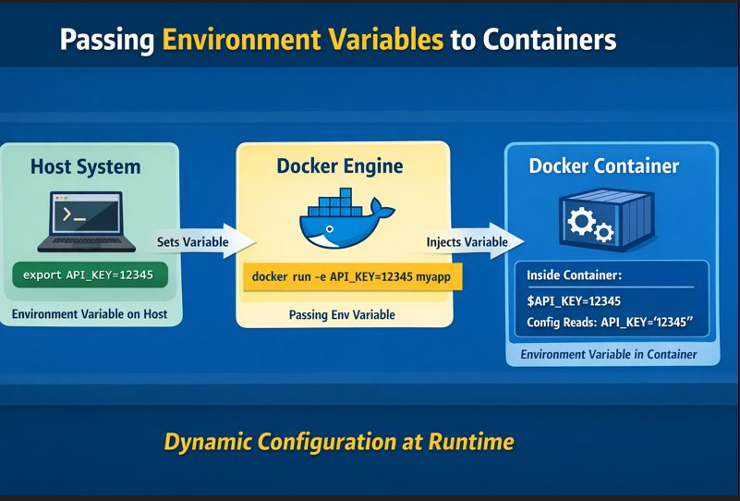

Slide 20
-p optional flag in run command
-p stands for publish port.
It maps a port on your host machine to a port inside the container.
In simple words:
-p allows users outside the container to access an application running inside the container.
By default:
Containers run in an isolated network
Applications inside containers are NOT accessible from the host/browser
So if a web server is running inside a container, you must expose it using -p.

Slide 21
Syntax of –p
docker run -p <HOST_PORT>:<CONTAINER_PORT> IMAGE
Part | Description
HOST_PORT | Port on your system (Laptop/Server)
CONTAINER_PORT | Port where app runs inside container

Slide 22
EX#1:
Without –p
docker run nginx
As no port mapping done here
Try opening browser: But it is Not accessible

Slide 23
Now try to Run Nginx with -p
docker run -p 8080:80 nginx
What happens internally?
Browser → localhost:8080 → Docker Host → Container:80 → Nginx

Slide 24
docker run -d -p 3307:3306 --name mysql-test –e MYSQL_ROOT_PASSWORD=root123 mysql
docker exec -it mysql-test bash
mysql -h 127.0.0.1 -P 3306 -u root –p

Slide 25
7 What’s running?
To lists all the docker containers are running with container details.
.
$ docker ps

Slide 26
TASK #1:
Run Ubuntu container
Pass -e COLLEGE=CSE
Show echo $COLLEGE
Stop container → variable disappears
Run Ubuntu container
Pass -e COLLEGE=CSE
Show echo $COLLEGE
Stop container then check what happened

Slide 27
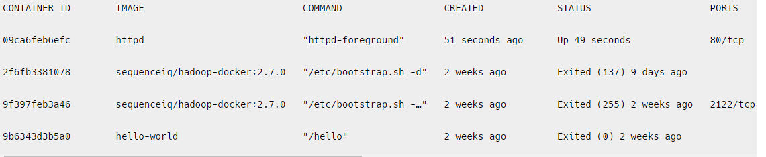
8. ps -a
To list all the docker containers running/exited/stopped with container details
$ docker ps -a

Slide 28
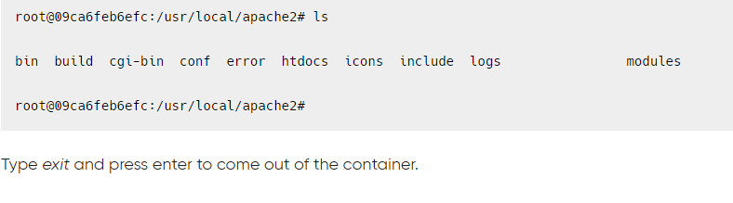
9. exec
Access the docker container and run commands inside the container in bash
$ docker exec -it 09ca6feb6efc bash/env
09ca6feb6efc --- it is Id of the container

